Slide 1
“The University Cooperative” Workshop
Learning to manage academic resources as common property
Sanli Faez
Physics Department, Utrecht University
https://tinyurl.com/uc-introduction
Mozilla Public License 2.0

Slide 2



Acknowledgments
Socrates Schouten (Waag)
Bianca Kramer (Utrecht University)
Barbara Vreede (Utrecht University)
Jeroen Bosman (Utrecht University)
Yara Al-Salman (Utrecht University)
Amir Raoof (Utrecht University)
Annemarie Kalis (Utrecht University)
Mozilla open leaders program:
Chad Sansing
Monica Granados
Brian Bot
Daniela Saderi

Slide 3


Why “Commons for Academics”?
Egocentric
Networked (open-science)
Credit: Carl Wiens

Slide 4
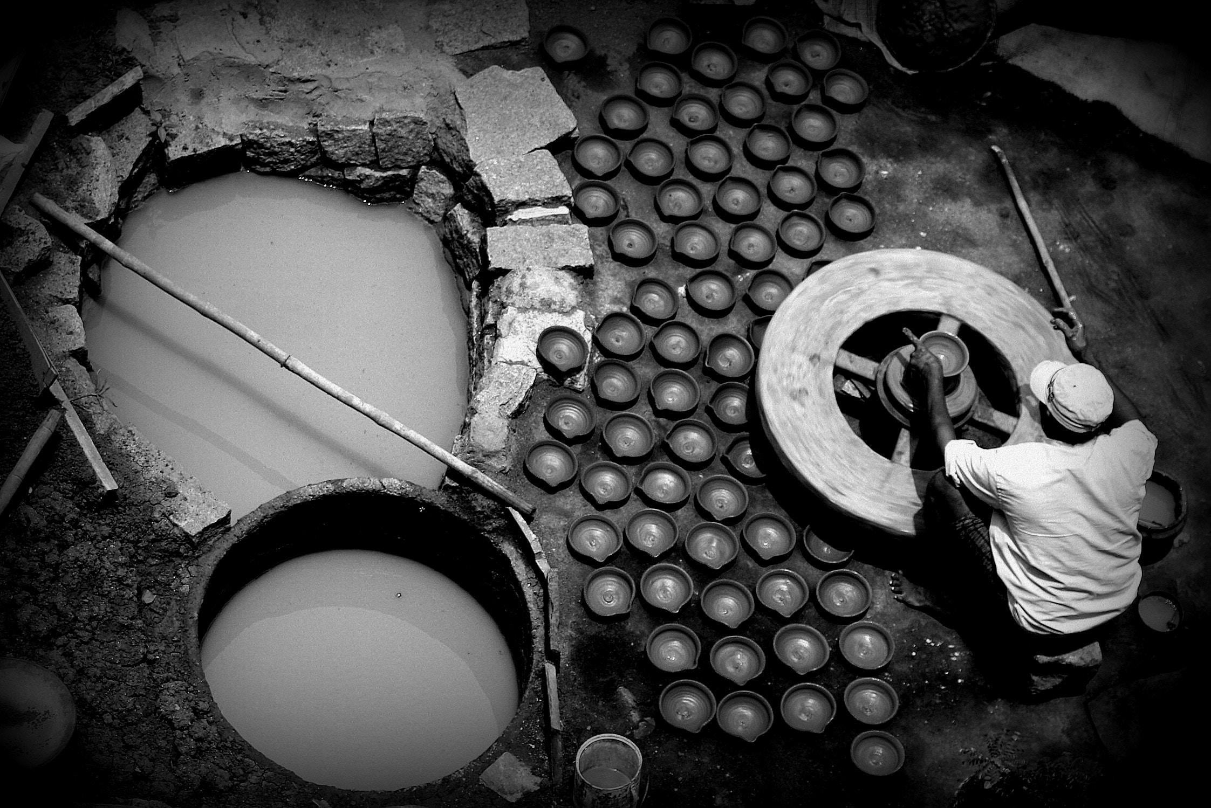
How not to drink from a broken jar?
If we want to be in charge of our shared resources,
what do we need to learn?
Which tools do we need?
What rights are we missing?
Photo by Phinehas Narra on Unsplash

Slide 5
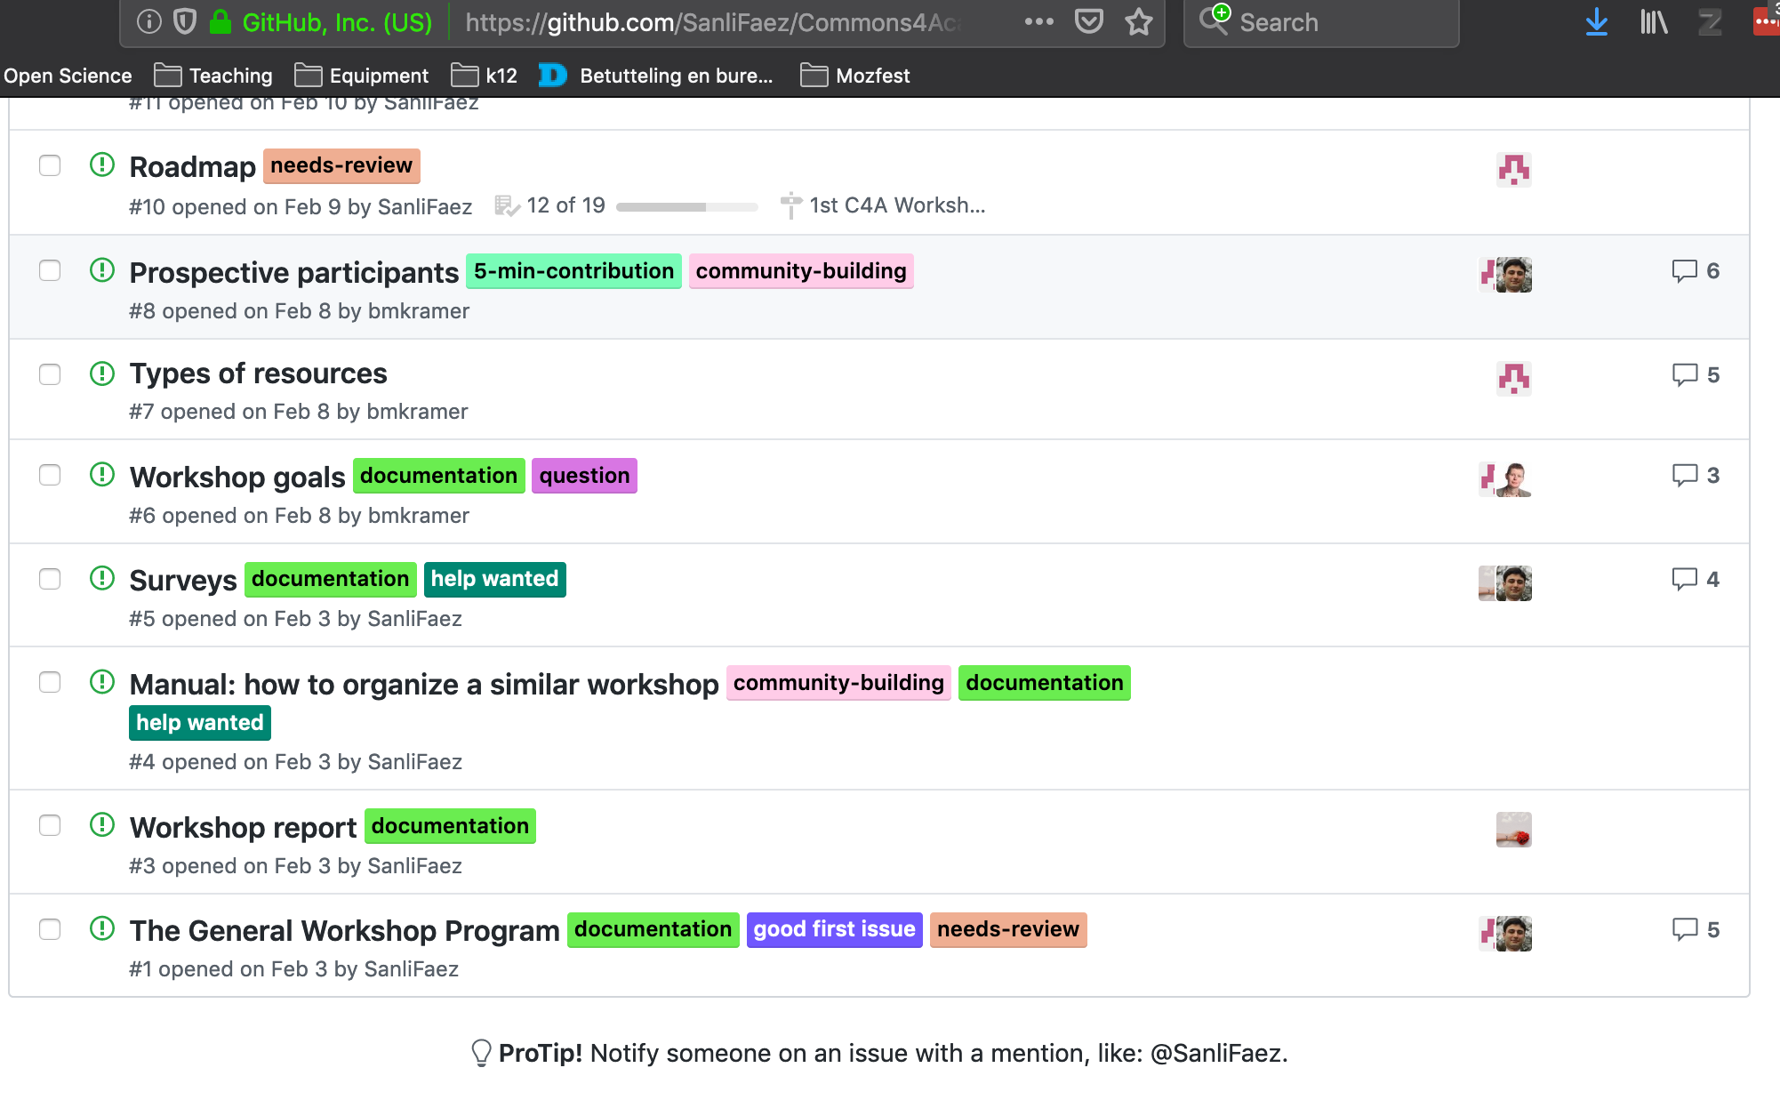
How to contribute
https://github.com/SanliFaez/Commons4Academics

Slide 6
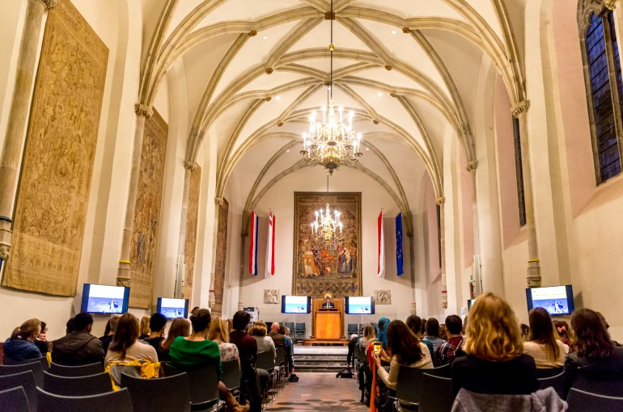
“The University Cooperative” workshop #1
Theory (10:20 - 11:40)
Solutions block (12:00 - 12:40)
Lunch (12:40 - 13:30)
Case studies (13:30 - 16:00)
Discussion and Closing (16:00 - 17:00)
Going for drinks afterwards, all of you are welcome to join!

Slide 7
points of order
This workshop is recorded for the purpose of making a podcast.
Photographs will be taken.
The surveys and evaluation are essential parts of the workshop.
We adhere to the OSCU code of conduct (https://openscience-utrecht.com/code-of-conduct/)
  OSCU is dedicated to diversity, equity, inclusion, and the free expression of ideas. OSCU seeks to provide an environment in which diverse participants may learn, discuss, network, and enjoy each others company in an environment of mutual respect.

Slide 8
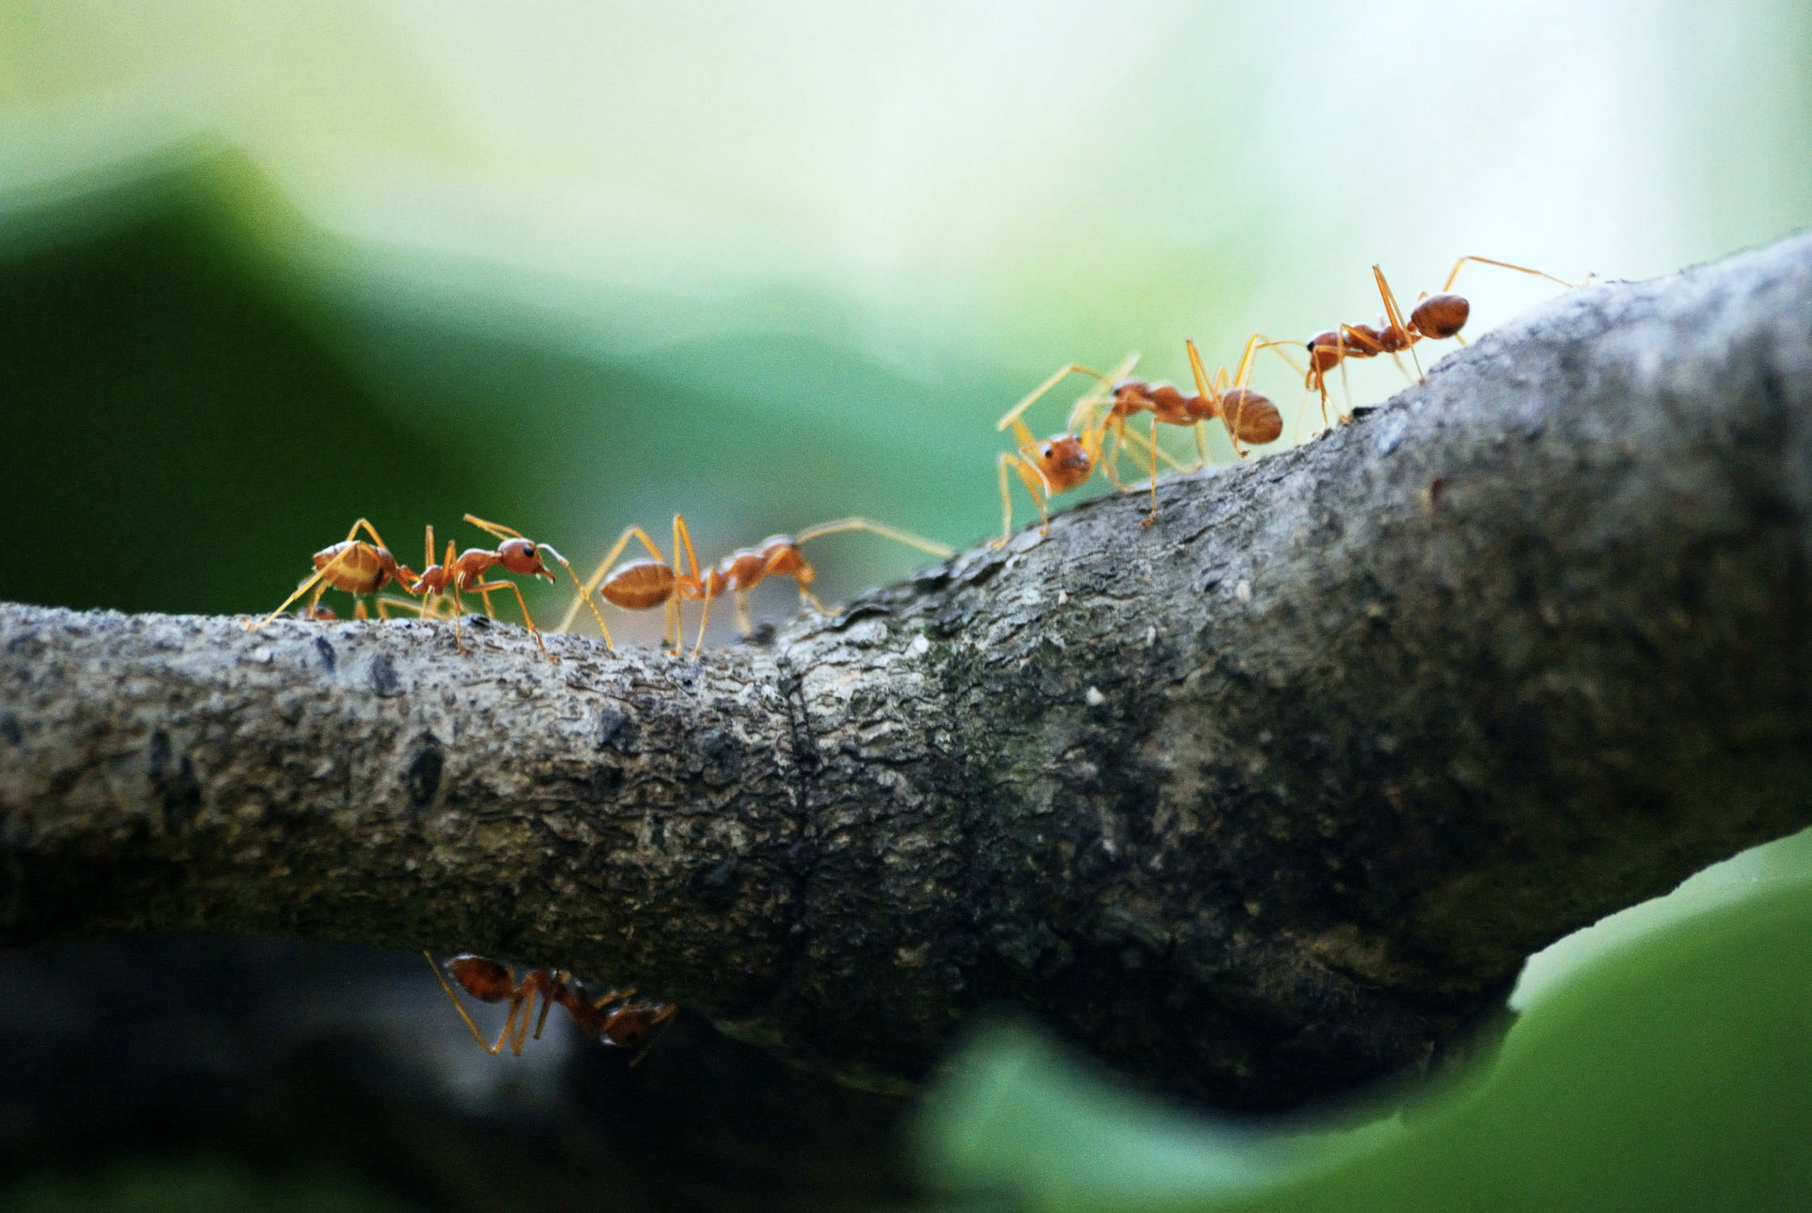
Next steps
Make a podcast from the workshop.
Make all materials available in order to reproduce the workshop with other cases.
Support the participants to realize their co-created solutions.
Encourage you and others to organize similar events.

Slide 9

Use case: allocating a library budget
Selecting journals (from 100+)
On a limited budget
Weighing a wide range of subjects
also:
How about data, tools, APCs?
Can the department have a say in the overarching ‘Big Deals’?
Does the budget play a role in the transition to Open Access?
"Trinity College, Dublin" by wattallan594

Slide 10
Use case: publish and perish
In a given discipline, there are 20000 article submissions each month, but a researcher has perhaps time to read only 20, and wants to read highest quality articles tailored to its interest. How to create a fair system of selection?
How to check novelty of a new submission?
How to avoid unnecessary duplication of work, especially for null results?
How to separate judging on quality and novelty?
How to avoid unnecessary duplication of work?
What is the roles of journals in this process?
How to better align benefits for readers and authors?

Slide 11
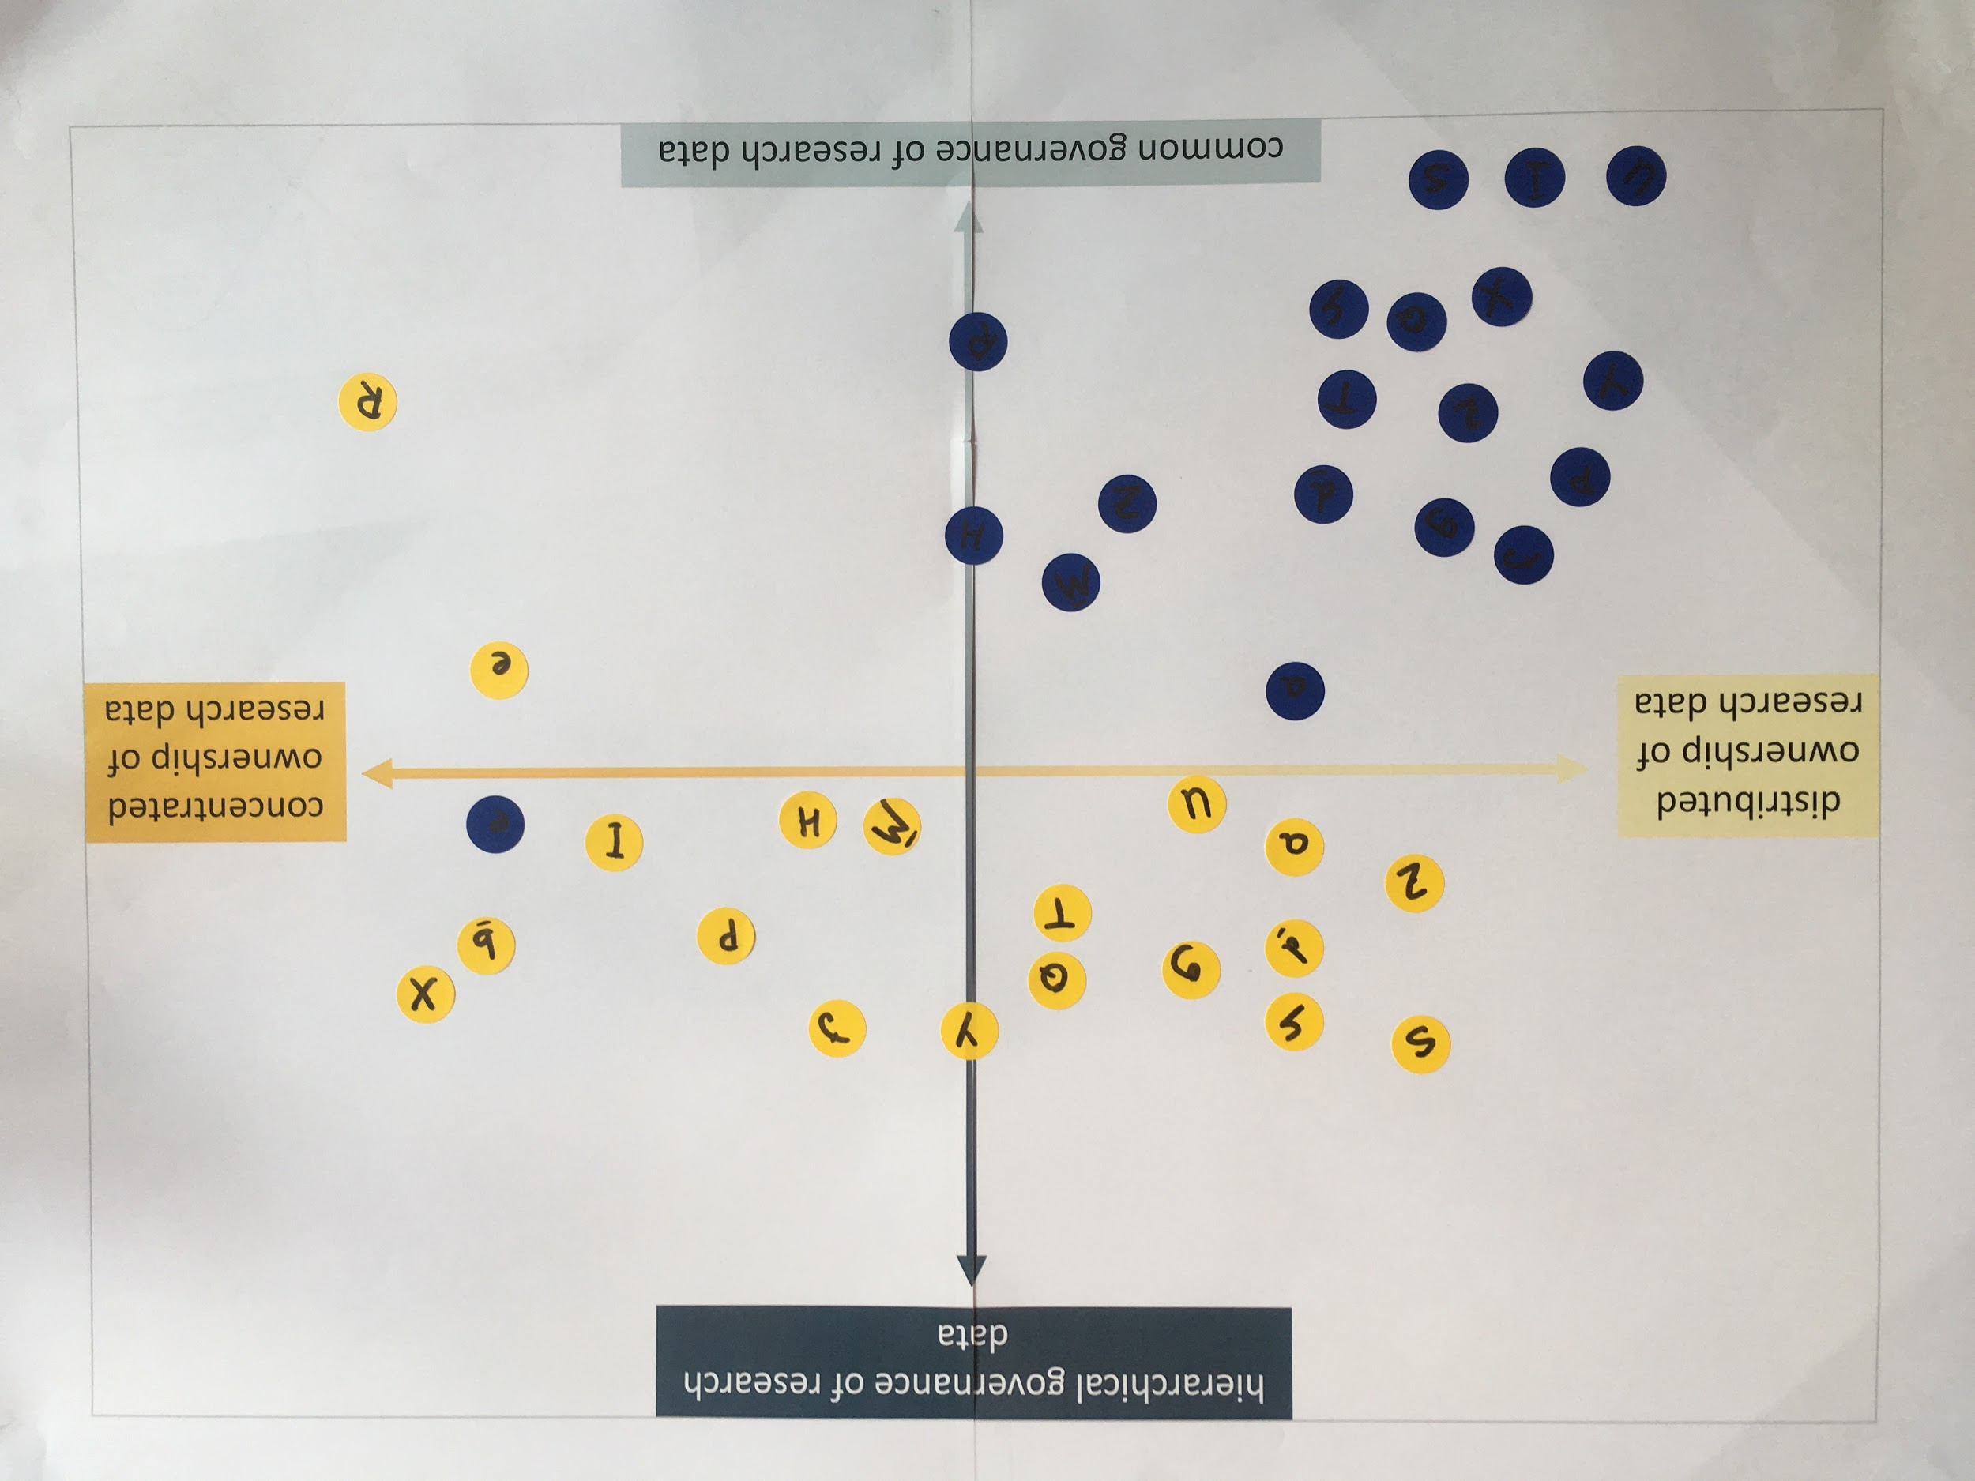
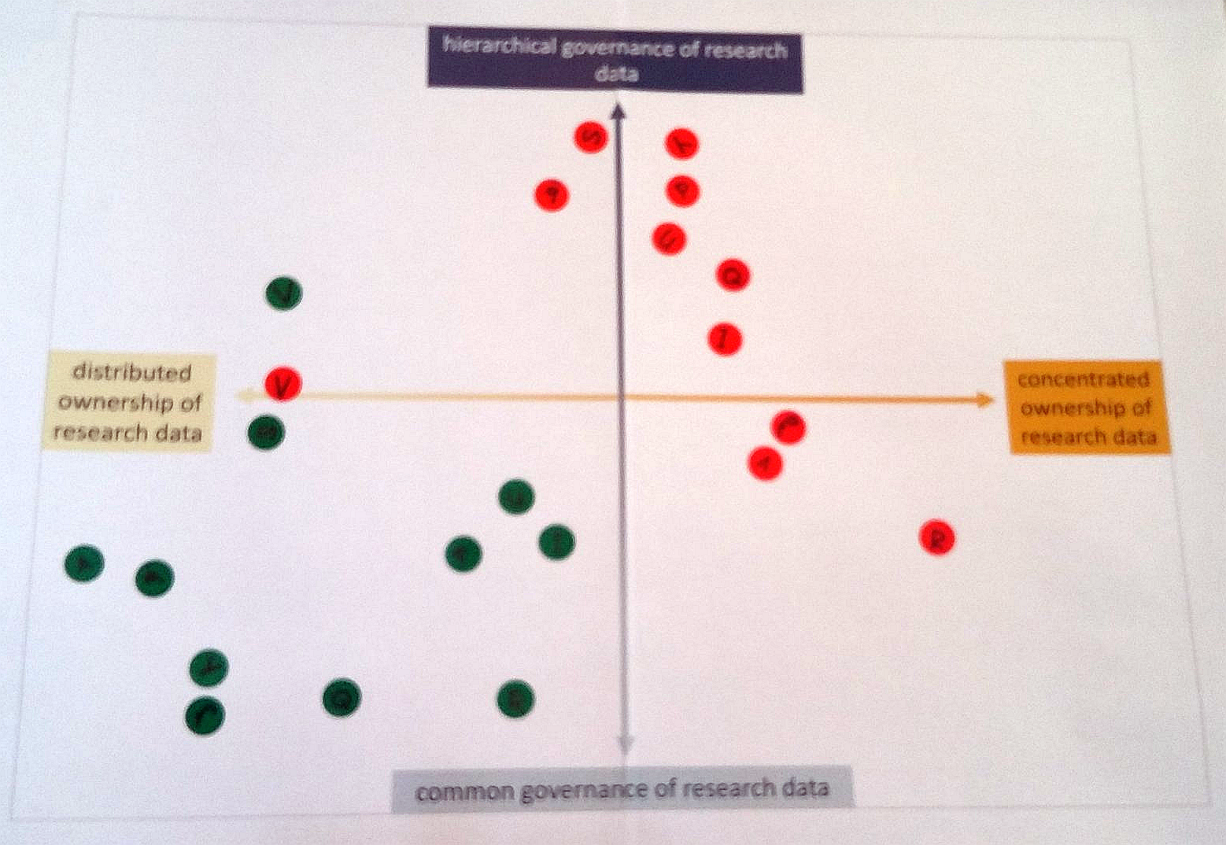
Research data
Before the workshop
After the workshop
current desired
current desired

Slide 12
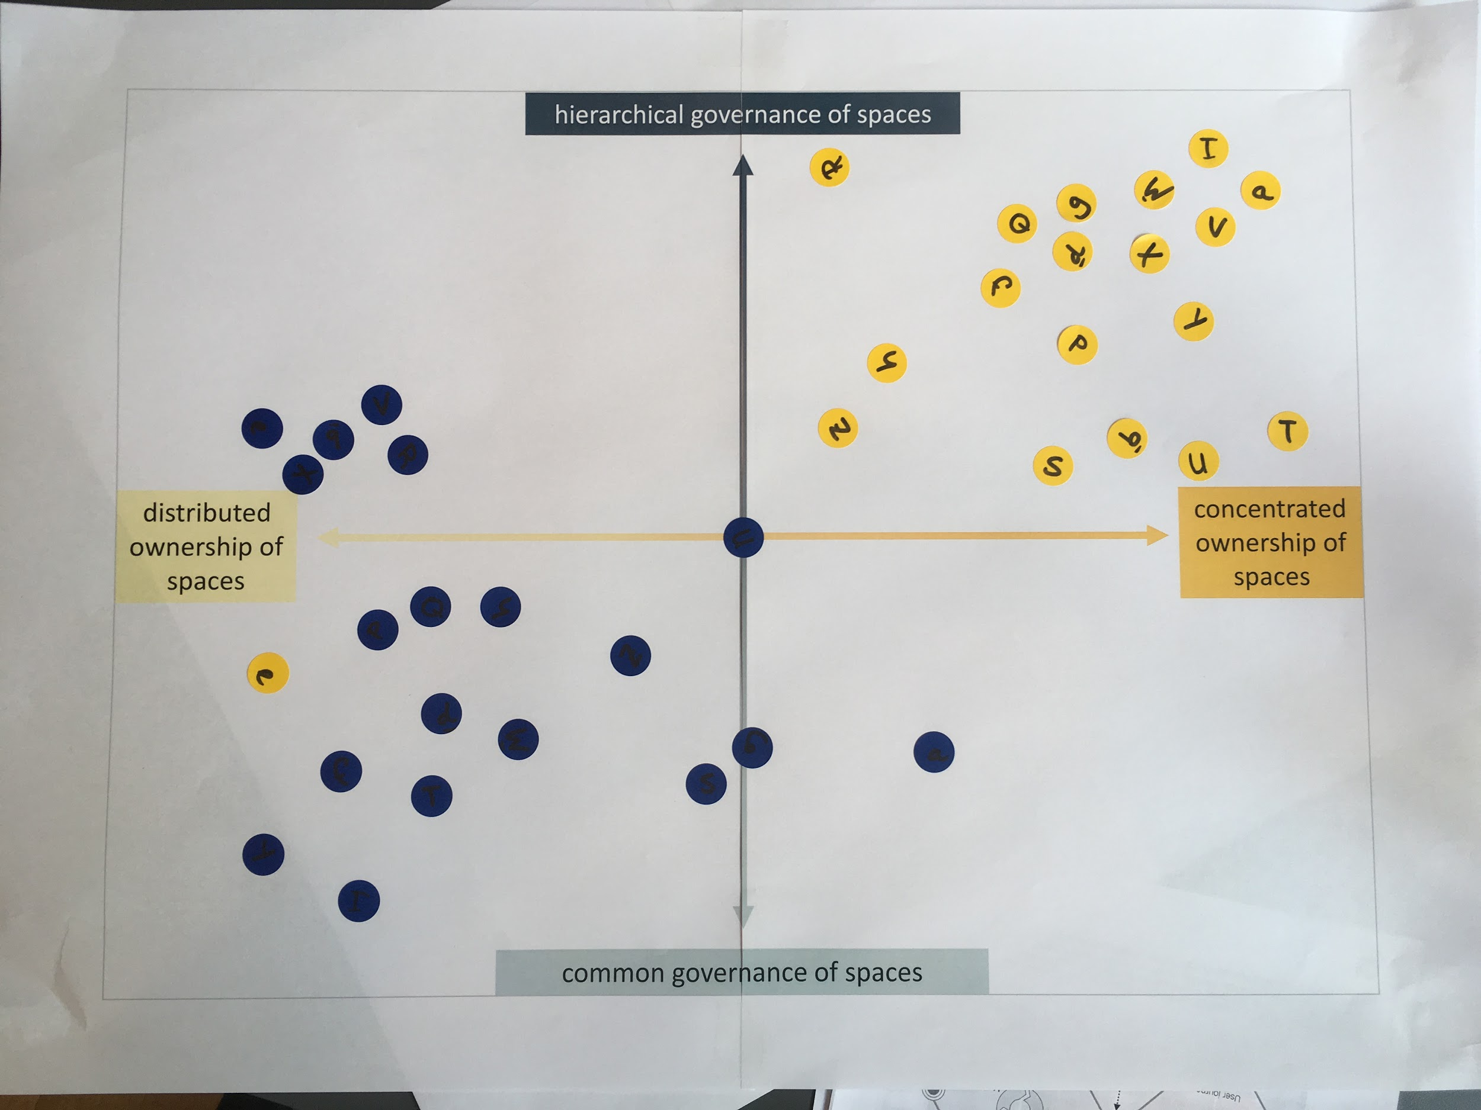
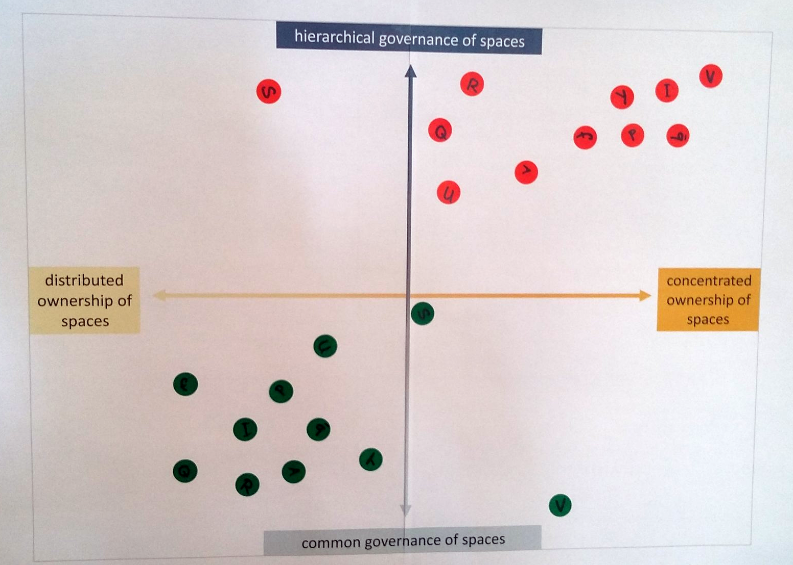
University spaces
Before the workshop
After the workshop
current desired
current desired

Slide 13
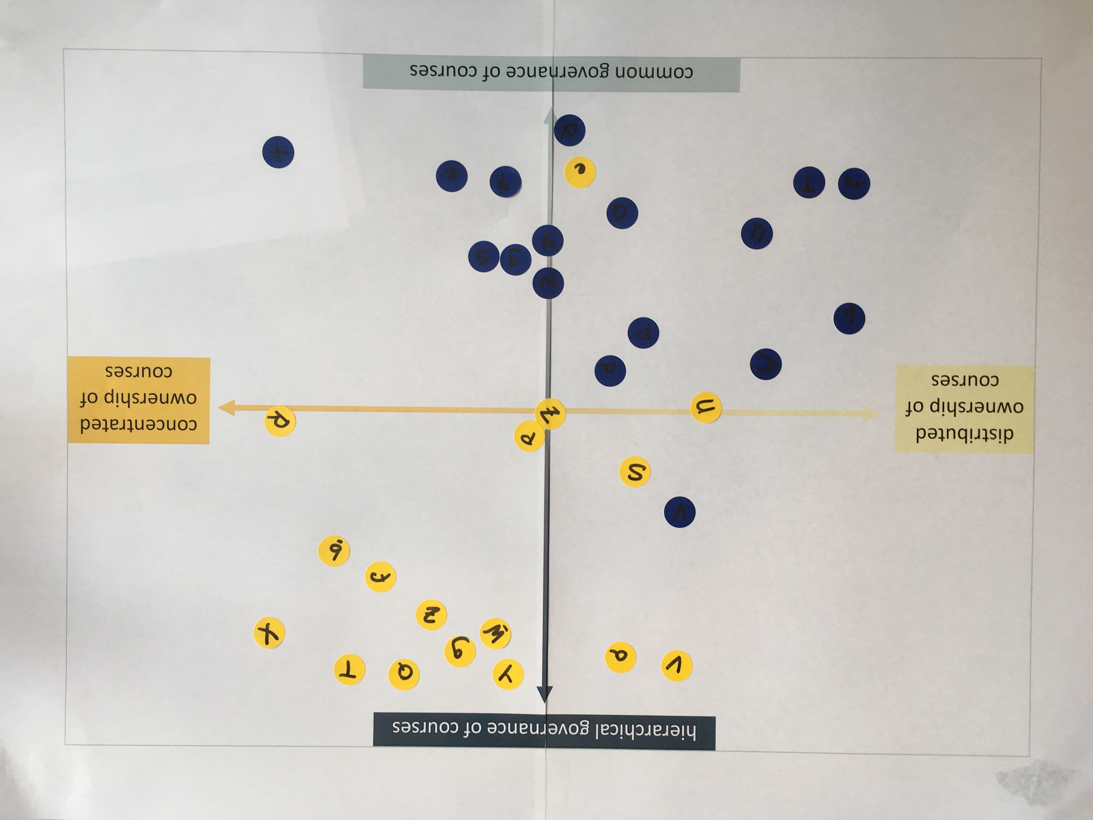
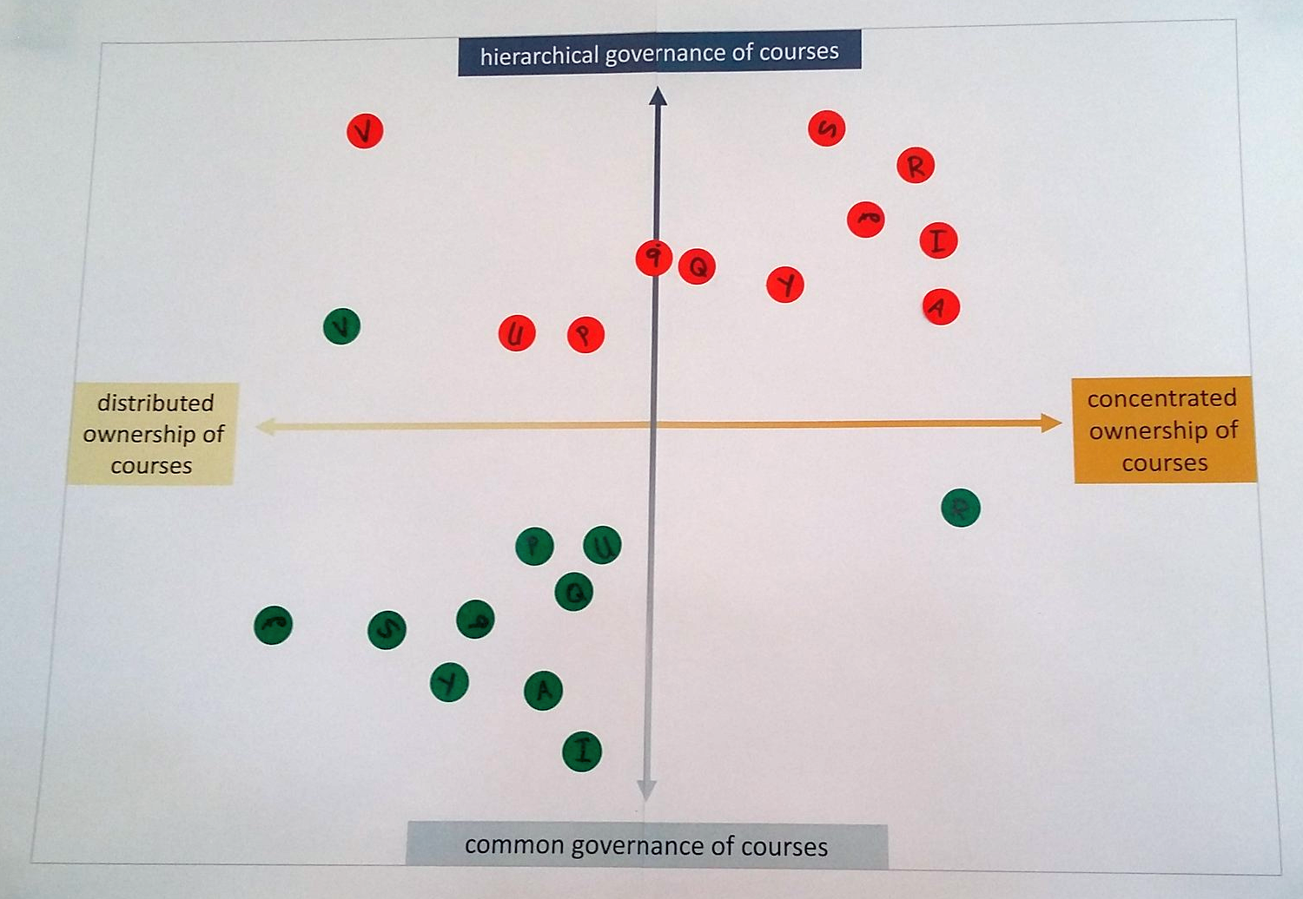
Academic courses
Before the workshop
After the workshop
current desired
current desired

